Slide 1
Powershell 101
How to Code in Powershell

Slide 2
01
03
05
Coding Hygiene
File Manipulation
Debugging
02
04
Essentials
Running Scripts
Things to know when coding in Powershell
Creating, writing, removing, and editing files
Finding and fixing errors in your code
The basics you will find in any language
How to run your scripts after you make them

Slide 3
01
Coding Hygiene
Things to know when coding in Powershell

Slide 4
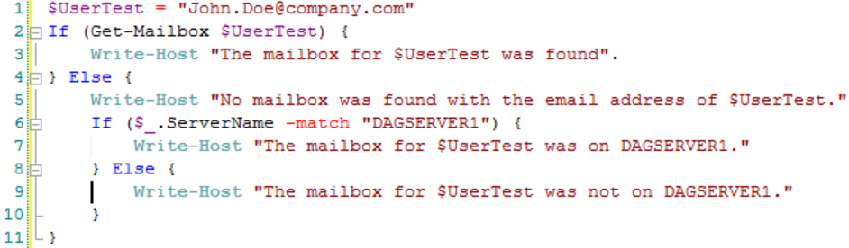
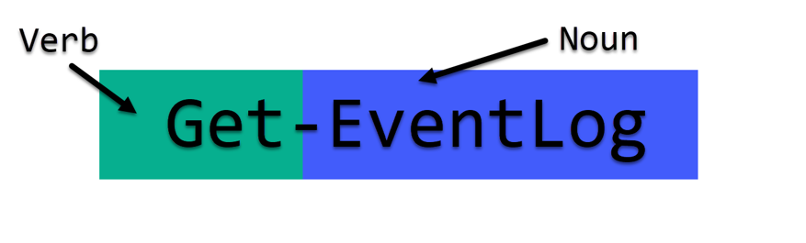
Dos
How to write effective code:
Use the complete cmdlet/function name (eg. Set-Location vs chdir)
Utilize proper capitalization (eg. Write-Host vs write-host)
Use consistent indentation and proper form
Keep it simple (less is more)
Use clear variable names (eg. $AppleTrees vs $appletrees

Slide 5
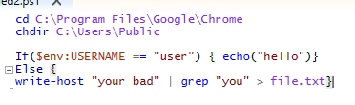

Don’ts
Use aliases in your code (makes it hard to read)
Use nondescript variable names (eg. $x vs $UserCount)
Have inconsistent indentation and braces/brackets
Be the only one who can read your code
  (You are on a TEAM!)

Slide 6
02
Essentials
Programming Basics

Slide 7
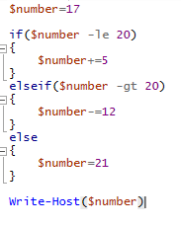
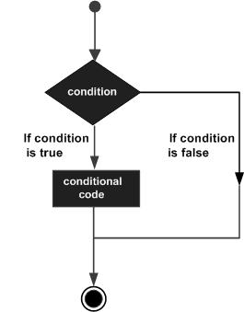
IF Statements
If statements are used to determine conditional values on whether or not code should run.
If’s have 3 states: If, Elseif, and Else.
If: Necessary, determines to run code based on whether or not the input is True or False
Elseif: Optional, runs another if statement if the previous one evaluated to False
Else: Optional, if all statements prior evaluated to false, this statement is run.

Slide 8
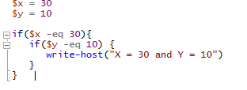
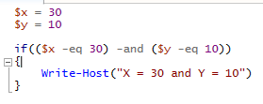
Nested Ifs:
If statements can be nested inside of each other to check multiple conditions.
Multiple Conditions:
If statements can have multiple conditions using “-and” and “-or”

Slide 9
Comparison Operators
-eq
-ge
-gt
-ne
-le
-lt
Equals; =
Evaluates to TRUE if both sides are equivalent
Greater or Equal to; >=
Evaluates to TRUE if the left side is greater than or equal to the right
Greater Than; >
Evaluates to TRUE if the left side is greater than the right
Not Equals; !=
Evaluates to TRUE if both sides are different
Less or Equal to; <=
Evaluates to TRUE if the left side is less than or equal to the right
Less Than; <
Evaluates to TRUE if the left side is less than the right

Slide 10
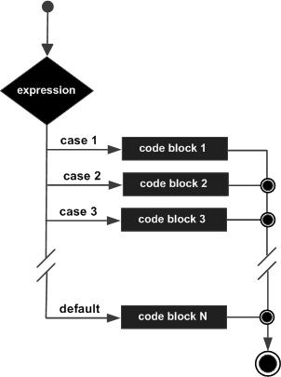
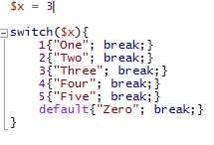
Switch Statements
Switch statements are useful to avoid using long If-Else chains.
A switch statement takes a singular input and selects an output based on the available choices.
Switch statements run top to bottom, so having a “break;” after each condition is proper form.

Slide 11
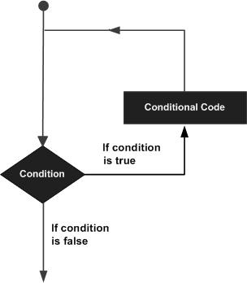
Loops
Loops are useful for doing repetitive tasks or for executing a statement multiple times.
There are four types of loops: For, ForEach, While, Do...While:
For: Execute a sequence of statements multiple times
ForEach: Enhanced For Loop. Executes statements on each element in a collection
While: Repeats a statement while the given condition is TRUE
Do...While: A while loop, except the test condition exists at the end of the loop

Slide 12
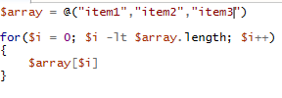
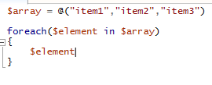
For Loop:
Given a variable, repeats the loop until a condition is met. Similar in syntax to Java
ForEach Loop:
Given a collection of items, such as an array, repeats a statement for each item

Slide 13
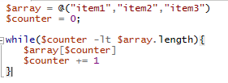
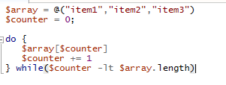
While Loops:
As long as the conditional statement is TRUE, it will continue to execute the code
Do...While Loops:
Same thing as a while loop, except it checks for the conditional statement at the end. This means that the code is guaranteed to run at least once.

Slide 14
03
File Manipulation
Writing, Reading, Editing, Executing, and Deleting

Slide 15
Folders
New-Item
-ItemType Directory
Copy-Item PATH_A PATH_B
Move-Item
PATH_A PATH_B
Test-Path
Remove-Item
Rename-Item
A directory is equivalent to a Folder. By running this command it will spawn a new folder at PATH.
Copies a folder from PATH_A to PATH_B. This also maintains all contents of the folder.
This removes the folder from the current path, PATH_A, and moves it to a new location, PATH_B.
If there exists a folder path at this location, then it will return TRUE, otherwise it’ll return FALSE.
Removes the folder at the given location. Also deletes the contents recursively.
Simply renames the folder. The folders should be exactly the same, the only difference being the name.

Slide 16
Files
New-Item
-ItemType File
Copy-Item PATH_A PATH_B
Move-Item
PATH_A PATH_B
Test-Path
Remove-Item
Rename-Item
File is data written to a location. By running this command it will spawn a new file at PATH.
Copies a file from PATH_A to PATH_B. This also maintains all contents of the file.
This removes the file from the current path, PATH_A, and moves it to a new location, PATH_B.
If there exists a filepath at this location, then it will return TRUE, otherwise it’ll return FALSE.
Removes the file at the given location. Also deletes the contents.
Simply renames the file. The files should be exactly the same, the only difference being the name.

Slide 17


Why are folders and files the same?
In Powershell, both treated as objects. The reason they can both be manipulated the exact same is because they are Items. Items generally have basic properties such as name and location. In this way we can manipulate those properties of the Folder and File Items.

Slide 18
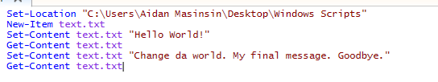
Reading Content:
Get-Content reads the information from inside any file.
Writing Content:
Set-Content changes the contents of the specified file.

Slide 19
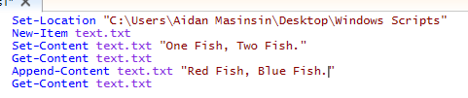

Adding Content:
Append-Content adds input content onto the end of the file instead of replacing it
Erasing Content:
Clear-Content clears all of the content inside of the file

Slide 20
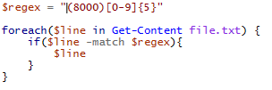
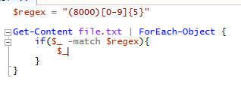
Reading File Line-by-Line
Using Foreach in Script:
Using Foreach-Object with Pipe:

Slide 21
04
Running Scripts
Getting the thing to run

Slide 22
Why is my script not running?
Set-ExecutionPolicy
The execution policy is the level in which scripts in powershell are allowed to run. This is to prevent any harmful or malicious scripts from being run without the user’s knowledge. There are 5 levels of execution policy:
Restricted
  Will not let ANY Powershell scripts to run, only individual commands
AllSigned
  Only SIGNED Powershell scripts can run
RemoteSigned
  Allows unsigned local scripts and SIGNED REMOTE scripts to run
Unrestricted
  Allows unsigned scripts to run, but will warn when running downloaded scripts
Bypass
  ALL scripts are allowed to run, no warnings or prompts

Slide 23
Powershell File Types
.ps1
.psm1
.psd1
.pssc
.psrc
.ps1xml or .cdxml
Powershell Scripts; most common type of PS file and similar to formats such as .bat or.sh
Powershell Modules; these contain multiple function scripts that interact as a package. These are imported with Import-Module or Install-Module
Powershell Data File; provide information and instructions for .psm1 files. Can serve as a help for Powershell Modules
Powershell Session Configuration File; Describes how the session environment is built. (We won’t be using this one)
Powershell Role Capability File;
Define a set of capabilities used in session configuration and .pssc files
Powershell XML;
XML is a common file format that marks up text. This is pretty much a .psd1 in an XML format.

Slide 24
05
Debugging
Squish those bugs

Slide 25

debugging
/ˌdēˈbəɡiNG/
Learn to pronounce
noun
the process of identifying and removing errors from computer hardware or software.
"software debugging"

Slide 26
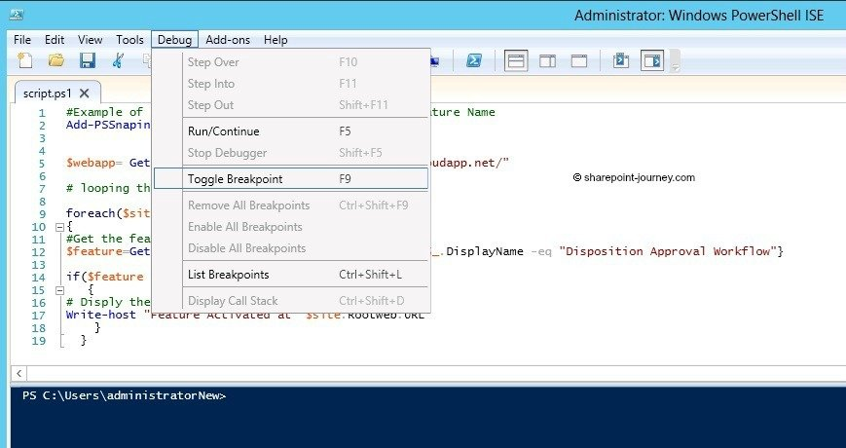
Breakpoints
Breakpoints are points in the code in which your code will stop in order to figure out what is wrong.
There are two ways to toggle breakpoints:
Right Click on Line + Toggle Breakpoint
F9 Key
During a breakpoint you can execute code in what is known as the debugger. This is a shell which is running the current instance of your script. From here you can choose to continue your script or write code in the debug shell.

Slide 27
Thanks!
Do you have any questions? youremail@freepik.com
+91 620 421 838
yourcompany.com
Please keep this slide for attribution.

Slide 28



Alternative Resources

Slide 29
Resources
Did you like the resources on this template? Get them for free at our other websites.
PHOTOS:
Friendly colleagues with devices at desk
Close-up happy guy wearing vr glasses
MOCK-UPS:
Simple modern business stationery
VECTORS:
Geometric logo collection
Neon lights technology background
Blue abstract hud technology background
Technology background
ICONS:
Technology Icon Pack

Slide 30
Instructions for use
In order to use this template, you must credit Slidesgo by keeping the Thanks slide.
You are allowed to:
- Modify this template.
- Use it for both personal and commercial projects.
You are not allowed to:
- Sublicense, sell or rent any of Slidesgo Content (or a modified version of Slidesgo Content).
- Distribute Slidesgo Content unless it has been expressly authorized by Slidesgo.
- Include Slidesgo Content in an online or offline database or file.
- Offer Slidesgo templates (or modified versions of Slidesgo templates) for download.
- Acquire the copyright of Slidesgo Content.
For more information about editing slides, please read our FAQs or visit Slidesgo School:
https://slidesgo.com/faqs and https://slidesgo.com/slidesgo-school

Slide 31
Fonts & colors used
This presentation has been made using the following fonts:
Montserrat
(https://fonts.google.com/specimen/Montserrat)
Montserrat Alternates
(https://fonts.google.com/specimen/Montserrat+Alternates)
#06bad6
#f3f3f3

Slide 32
Use our editable graphic resources...
You can easily resize these resources without losing quality. To change the color, just ungroup the resource and click on the object you want to change. Then, click on the paint bucket and select the color you want. Group the resource again when you’re done.

Slide 35
JANUARY
FEBRUARY
MARCH
APRIL
MAY
JUNE
PHASE 1
Task 1
Task 2
PHASE 2
Task 1
Task 2
JANUARY
FEBRUARY
MARCH
APRIL
PHASE 1
Task 1
Task 2

Slide 38
...and our sets of editable icons
You can resize these icons without losing quality.
You can change the stroke and fill color; just select the icon and click on the paint bucket/pen.
In Google Slides, you can also use Flaticon’s extension, allowing you to customize and add even more icons.

Slide 39
Educational Icons
Medical Icons

Slide 40
Business Icons
Teamwork Icons

Slide 41
Help & Support Icons
Avatar Icons

Slide 42
Creative Process Icons
Performing Arts Icons

Slide 43
Nature Icons

Slide 44
SEO & Marketing Icons

Slide 45


